Slide 1
SQL Query Review
An Refresher and How-To Profile Data using SQL

Slide 2
Goals of the Activity
Learn to connect to our IST722 Server and use its databases.
Data profiling – “Getting to know your data”
Why is it important?
How to you use SQL to do it?
Why use SQL to do this?
Review of SQL Important to the course
Mastering SELECT and JOINS
Understand the need for data warehousing

Slide 3
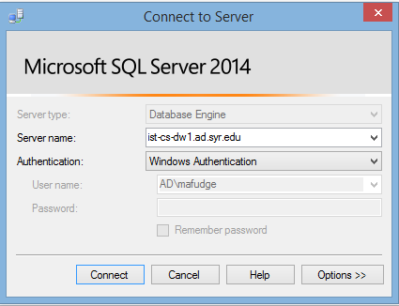
Connecting to the IST722 SQL Server in the Labs
Server Name
ist-cs-dw1.ad.syr.edu
Credentials
Windows Authentication NOTE: Uses identity of current logged on user, so you must connect from a lab or remote lab computer!

Slide 4

Connecting: Remote Lab
Remote Desktop Access to iSchool Labs.
Easy to use. Works from anywhere!
For when you need to use our software to complete your work for this course, but you cannot get to the computer labs.
https://remotelab.ischool.syr.edu

Slide 5
Connecting: Your Own Device
IMPORTANT: These instructions are for advanced users. No support will be given to students using this option. Instructions provided as-is.
Steps:
Install SQL Server Developer Edition.
NOTE: It must be this version as SSAS and SSIS are required.
Make an Off-Domain Shortcut. https://answers.syr.edu/display/ischool/Connecting+to+Microsoft+SQL+Server+-+OFF+domain

Slide 6

IST722 Databases on the Server
Data Warehouse DB
OLTP Source for Sample Data
Sources we use in our Project
Sample OLTP Retail DB
Your workspace for DW data
Your workspace for Stage data
Netflix movie / DVD rental data
Sample Retail data for Labs

Slide 7
Demo: Connecting to the Server
Let’s connect to the server and browse the databases.

Slide 8
What is Data Profiling?
The analysis of data sources to be used in the data warehouse.
Goals
Understand: Structure, content, relationships, and quality of your data and metadata (schema).
Recognize the features and limitations of your data source.
Checklist, per table:
What does a single row in this data set mean?
What makes each row unique? (Business Key)
What are the relationships among the data?
Do you understand the schema? (Column Definitions)
A.k.a “Getting Intimate With Your Data”

Slide 9
Data Warehousing is about:
empowering business users to make intelligent decisions with their data…
…Which is difficult because typically our data is in a format less conducive to this goal.

Slide 10
Business Questions
Remote Lab Data Set Questions
When was the most recent login?
On which days was the Remote Lab Full?
What’s the GPA of the last 10 students who logged in?
What are the majors of non-ischool students who logged in the last 2 months?
How many logins in the month of November 2014?
How many freshman used remote lab last semester?
How many different / unique Sophomores logged on in December 2014?
How many students did not login to remote lab?
What was the busiest time of day? Day of week?
Which days of the week are busier than the average?
How do we go about answering these questions?

Slide 11
SQL SELECT ➔ Reads Data
Columns To Display
SELECT col1, col2, ...
FROM table
WHERE condition
ORDER BY columns
Table to use
Only return rows matching this condition
Sort row output by data in these columns

Slide 12
SQL SELECT STATEMENT
HOW WE “SAY” IT
HOW IT IS PROCESSED
SELECT (Projection)
FROM
WHERE
ORDER BY
FROM
WHERE
SELECT (Projection)
ORDER BY

Slide 13
Examples:
On which dates was the Remote Lab Full?
When was the most recent login?
Before you begin, you’ve got to know your data:
What does one row in the table mean?
What makes each row unique?
What do the columns mean?

Slide 14
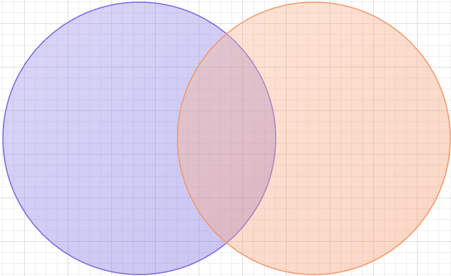
JOINS
JOINS let you combine data from more than one table into your query output
Most of the time you join on PK-FK pairs
Any columns of the same type can be joined
Most common join is an inner join
SELECT *
FROM tablea
JOIN tableb ON acol = bcol
tablea
join
tableb

Slide 15
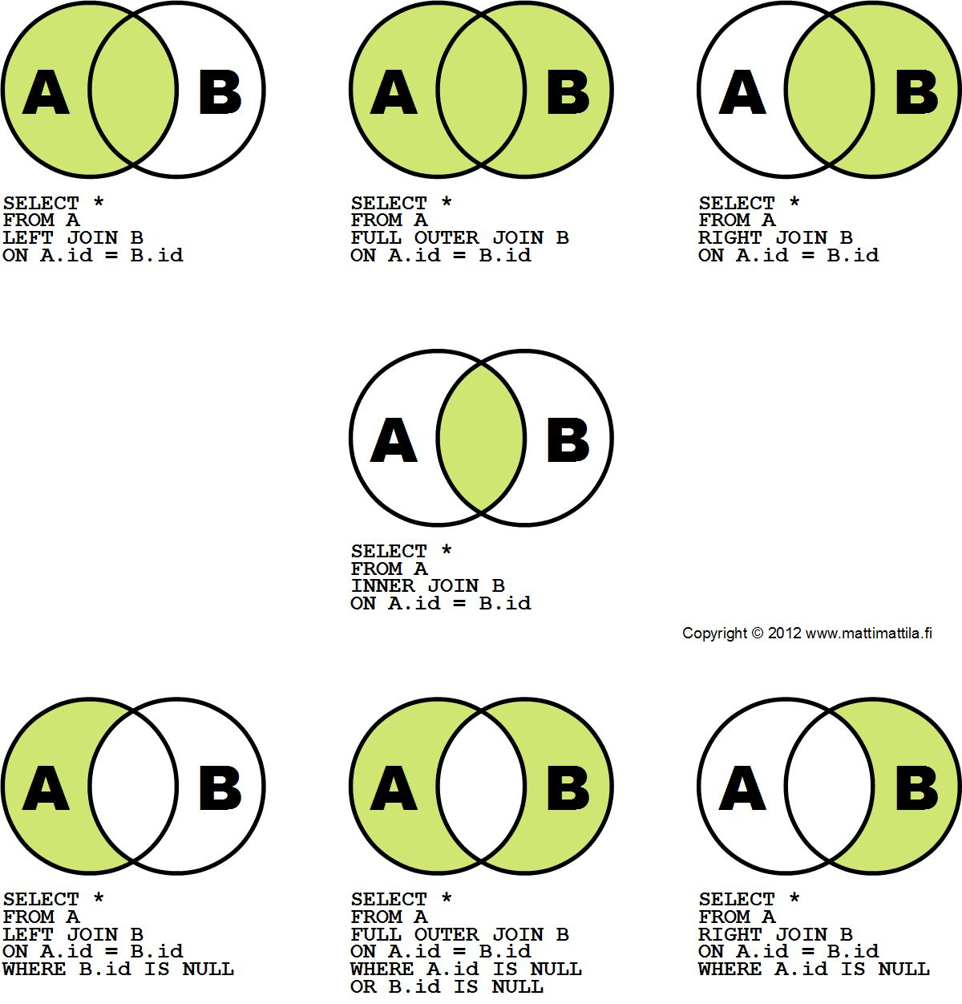
Outer Joins
For those situations where you need to include rows from one or more tables across the join criteria.
In the diagram, let’s assume
A == Customers
B == Orders

Slide 16
Examples:
What’s the GPA of the last 10 students who logged in?
What are the majors of non-ischool students who logged in the last 2 months?
Is there anyone who used remote lab but is not in the student table?

Slide 17
Aggregates
They summarize your data… You no longer get a real row returned, but a summary of rows from the table.
Aggregate operators:
Count, Count distinct, Sum, Min, Max, Avg
GROUP BY Columns which the aggregate operator will summarize by.
HAVING Like WHERE only filters after the aggregate has been done.

Slide 18
FULL SQL SELECT STATEMENT
HOW WE “SAY” IT
HOW IT IS PROCESSED
SELECT (Projection)
TOP / DISTINCT
FROM
WHERE
GROUP BY
HAVING
ORDER BY
FROM
WHERE
GROUP BY
HAVING
SELECT (Projection)
ORDER BY
TOP / DISTINCT

Slide 19
Examples:
How many logins in the month of November 2014?
How many undergrads freshman / so / jr / sr used remote lab last semester?
How many different / unique Sophomores logged on in December 2014?
How many students did not login to remote lab?
What was the busiest time of day? Day of week?

Slide 20
Sub Selects
The full power of the SELECT statement in that you can use it as a table, column or condition for another SELECT statement.
In FROM: SELECT x.* FROM (SELECT * FROM table1) x
In Projection: SELECT (SELECT TOP 1 col1 FROM table1 ) col1 FROM table2 y
In WHERE: SELECT x.* FROM table1 x WHERE x.col1 IN (SELECT col1 FROM table2 )

Slide 21
Examples
Which days of the week are busier than the average (from a count of logins)?
For the last semester’s logins for ischool grad students only, list program, total logins per program, total logins for all grads and the percentage total for each program. Example: Program Lgns Total PctOfTot LIS 100 500 20% IM 250 500 50% TNM 150 500 30%

Slide 22
Handling Slow Query Processing
Sometimes your source is not responsive enough for data exploration.
Fix:
Copy source data into your Operational Data Store SELECT * INTO newtable FROM … or INSERT INTO table SELECT * FROM …
Set your business keys as primary keys of the table.
If performance still lags, Index as required / suggested.
This is a temporary solution, just for profiling.

Slide 23
Activity Summary
Data Warehousing is about empowering business users to make intelligent decisions with their data. So…
How would a business user get these questions answered?
This is hard work… and you’re technically savvy.
It’s not practical to write an SQL statement for every business question we need answered. That does not scale!
We need to find a better way to re-organize this data so that we can accomplish the end goal of empowering business users.
That’s rationale behind data warehousing and the essence of what you’ll learn in this course.

Slide 24
SQL Query Review
An Refresher and How-To Profile Data using SQL

